Slide 1
XIV International Conference on Economic and Social Development, 2-5 April 2013, Moscow
A new copula approach for high-dimensional real world portfolios
Wolfgang Aussenegg, Vienna University of Technology
Christian Cech, University of Applied Sciences bfi Vienna

Slide 2
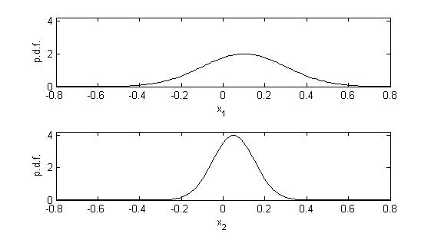
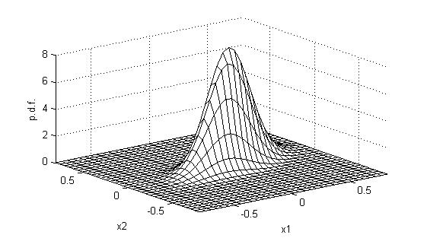
Introduction
We present a new parsimonious approach to calibrate a Student t copula for high dimensional data sets
The most widely used market risk model: Variance-Covariance model
serves as benchmark
weaknesses (empirical evidence):
daily (univariate) asset returns are not normally distributed but display „heavy tails“
the dependence structure (the copula) is non-Gaussian, as a higher probability of joint extreme co-movements is observed
marginal distributions:
non-Gaussian
Copula: non-Gaussian
multivariate distribution: non-Gaussian
C

Slide 3
Introduction
Models that use a Student t copula – meta Student t models – seem an appropriate alternative
However these models are computationally intensive and hence time-consuming
This leads us to propose a parsimonious copula-parameter calibration process where the parameter “degrees of freedom”, ν , is estimated on the basis of bivariate data-pairs
We conduct a hit test for VaR(99%, 1day) estimates
20 years of daily data (n = 4,746), rolling window of 250 trading days
Equally weighted portfolio consisting of 21 financial assets
Models tested
Variance-Covariance model
meta-Gaussian model
new meta-Student t model
historical simulation

Slide 4
Copula approaches
The main advantages of copula-based approaches is that they allow for a separate modelling of
the marginal distributions (→ financial asset returns)
the copula (→”dependence structure” or “correlation”)
We examine the goodness-of-fit of two elliptical copulas with parameters
Gaussian copula:
correlation matrix P
Student t copula:
correlation matrix P
degrees of freedom ν (scalar parameter) the lower ν , the higher is the probability of joint extreme co-movements
The Gaussian copula is a special case of the Student t copula where ν → ∞
Recent studies have shown that the Gaussian copula underestimates the probability of joint severe losses. → use Student t copula

Slide 5
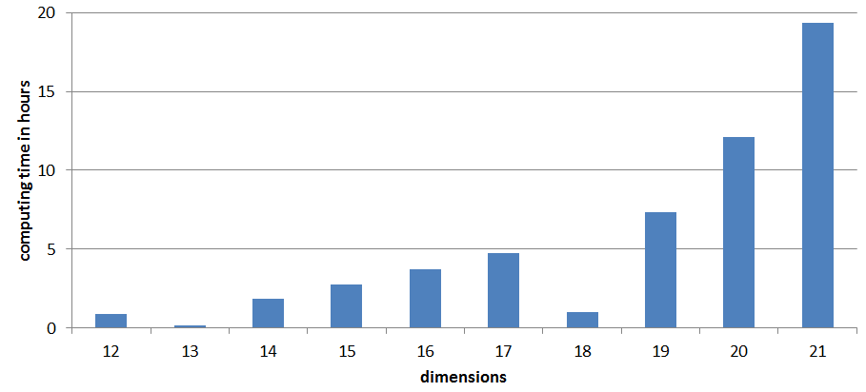
Student t copula
The drawback of the Student t copula is that the calibration is very time-consuming
for high-dimensional data sets and
if ν is large
Small simulation study: Calibration time for Student t copula We simulate random data of 250 sets for different dimensions (Gaussian copula rvs, only one scenario)

Slide 6
Student t copula
This motivates our newly proposed parsimonious calibration procedure based on bivariate pairs of observations
Construct bivariate pairs (→ $\frac{d\left(d−1\right)}{2}$ pairs) For each of these pairs, calibrate a Student t copula and store the parameter ${\hat{ν}}_{i}$
Use the median of the parameters ${\hat{ν}}_{i}$ as the parameter $\hat{ν}$ for the d-dimensional Student t copula
Approximate the correlation matrix by using the Gaussian copula parameter ${\hat{P}}_{G}$ as proxy for the Student t copula parameter ${\hat{P}}_{t}$ (→ faster than calibrating ${\hat{P}}_{t}$ and conservative approach)
Calibration of a 21-dimensional data set with 250 observations takes less than 1 minute
An alternative version of the above algorithm uses a rolling window of only 50 trading days (instead of 250 days) to estimate $\hat{ν}$. The advantage of this approach is that $\hat{ν}$ adjusts more quickly to reflect more recent market data.

Slide 7
Estimation of VaR
We estimate the 99% 1-day VaR on a daily basis using a rolling window of the 250 most recent observations
Variance-Covariance model
Assumes multivariate Gaussian distribution
VaR is estimated on the basis of sample-covariance-matrix (→ expected return is ignored)
Historical simulation
Copula models
Estimate copula parameters with the pseudo-log-likelihood method
Simulate 10,000 scenarios of 21-dimensional copulas
Use the simulated copula scenarios to compute scenarios of a 21-dimensional asset return distribution. Model the marginal distributions as Gaussian-kernel-smoothed distributions based on the 250 most recent observations.
VaR: 1%-quantile of the 10,000 scenario portfolio returns

Slide 8
Data
Daily log returns of 21 financial assets from August 1st, 1990 to July 30th, 2010 (n = 4,997)
We examine an equally weighted portfolio consisting of these assets
Financial assets:
Foreign exchange (3 assets)
Blue-chip stocks (6 assets)
Stock indices (3 assets)
Commodities (3 assets)
Fixed-income instrument with different maturities (6 assets)
USD-investor perspective
Data source: Thomson Reuters 3000 Xtra

Slide 9
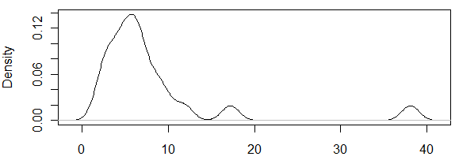
Data
Boxplot of univariate return time series:
(one outlier for oil is not shown: -40.66%)
All time series are leptokurtic
excess kurtosis

Slide 10
Hit test
We conduct a hit test to assess the appropriateness of our models
We make 4,746 out-of-sample forecasts of the 1% portfolio return quantile (→ 99% VaR) and count how many times the next day’s portfolio return is below the forecast (“hit”)
For a correctly specified model we expect to observe about 47 hits
Results Kupiec Hit Test (n = 4,746)
Model | # hits | % hits | Kupiec p-value
Variance-Covariance | 91 | 1.92% | 0.00%
Meta-Gaussian | 74 | 1.56% | 0.03%
Meta-Student [n=250] | 69 | 1.45% | 0.33%
Meta-Student [n=50] | 66 | 1.39% | 1.07%
Historical Simulation | 66 | 1.39% | 1.07%

Slide 11
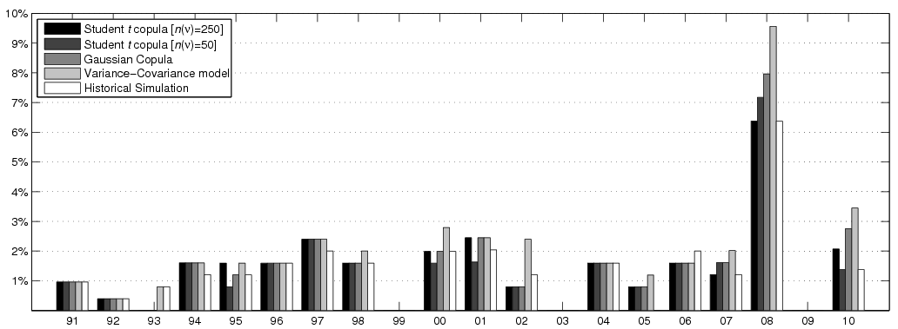
Hit test
The performance of the models varies over time:
The main reason for the poor model performance is due to the poor performance of the models in 2008
% hits

Slide 12
Hit test
Results Kupiec Hit Test without 2008 (n = 4,495)
In our data sample, the meta-Student t models perform better than the meta-Gaussian model This is because ν, the degrees of freedom, are explicitly calibrated in the meta-Student t models, while for the meta Gaussian model ν = ∞ → Let us have a closer look at the parameter ν !
Model | # hits | % hits | Kupiec p-value
Variance-Covariance | 67 | 1.49% | 0.21%
Meta-Gaussian | 54 | 1.20% | 18.85%
Meta-Student [n=250] | 53 | 1.18% | 24.06%
Meta-Student [n=50] | 48 | 1.07% | 65.11%
Historical Simulation | 50 | 1.11% | 45.71%

Slide 13
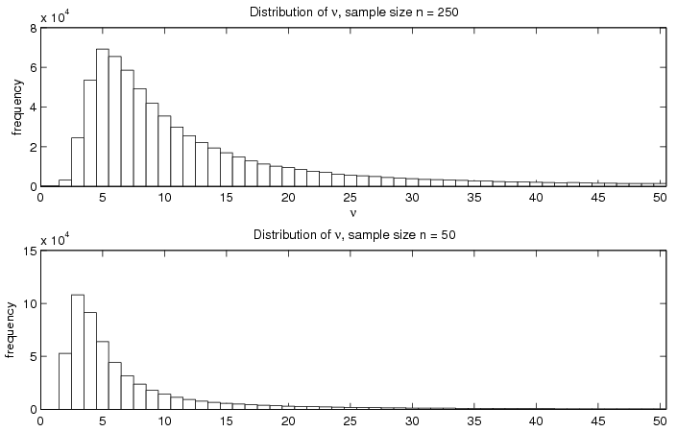
Hit test: parameter ν
Distribution of the bivariate estimates of ν (n = 996,660)
A substantial fraction of ν estimates is very high, hence the copula resembles a Gaussian copula
Fractions:
Distribution of those ν estimates that are low
model | ν > 100 | ν > 1,000
n = 250 | 29% | 26%
n = 50 | 45% | 44%

Slide 14
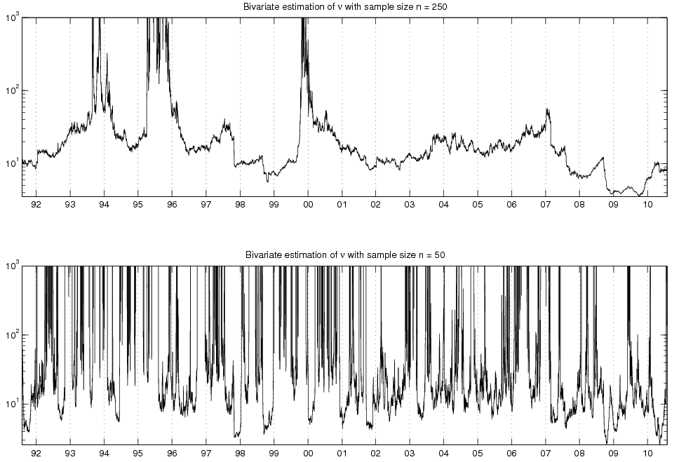
Hit test: parameter ν
Evolution of the median of ν (from 210 daily bivariate estimates)

Slide 15
Hit test: GARCH (1,1) innovations
The results from the hit test for our meta-Student t model are unsatisfactory, as the model should also be consistent in a turbulent market environment (like 2008).
Additionally we want to account for volatility clustering and apply the models on innovations of a GARCH(1,1) process.
Results Kupiec Hit Test (n = 4,746), GARCH(1,1) innovations
Model | # hits | % hits | Kupiec p-value
Variance-Covariance | 65 | 1.37% | 1.54%
Meta-Gaussian | 52 | 1.10% | 51.42%
Meta-Student [n=250] | 43 | 0.91% | 43.71%
Meta-Student [n=50] | 45 | 0.95% | 71.73%
Historical Simulation | 55 | 1.16% | 28.33%

Slide 16
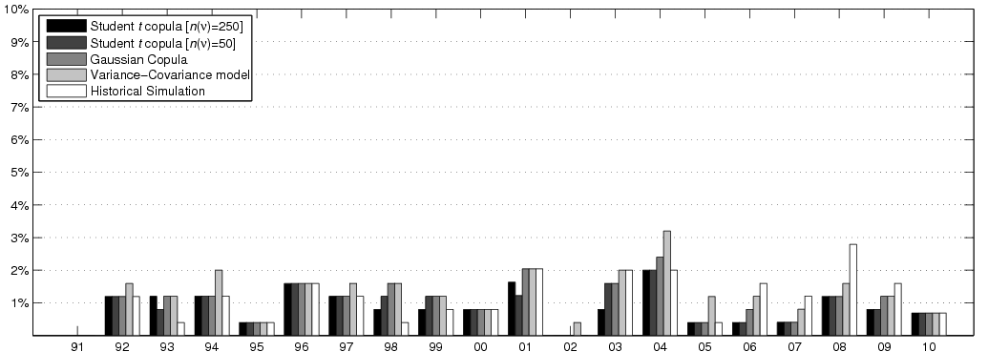
Hit test: GARCH (1,1) innovations
A significantly larger percentage of hits in 2008 cannot be observed for meta-Student t models
% hits

Slide 17
Conclusion
5 models are employed, the widely used Variance-Covariance model serves as benchmark
H₀: “correct model specification” can be rejected at the 5% significance level for all models
This is due to the weak performance of all models in 2008
Applying the models to GARCH(1,1) innovations leads to a considerable improvement
The weaknesses of the Variance-Covariance models stem from
an inappropriate modeling of the marginal distributions (i.e. univariate asset return distributions)
an inappropriate modeling of the ‘dependence structure’ (copula)
Not accounting for volatility clustering
Noteworthy: good performance of the simple historical simulation model. However: Confidence level cannot be higher than 99.6%

Slide 18
XIV International Conference on Economic and Social Development, 2-5 April 2013, Moscow
A new copula approach for high-dimensional real world portfolios
Wolfgang Aussenegg, Vienna University of Technology
Christian Cech, University of Applied Sciences bfi Vienna

