Slide 1
APEC’s strategic objectives and
regional economic integration
initiatives
24 November 2011 • Singapore
Presented by
Denis Hew, PhD
Director
Policy Support Unit, APEC Secretariat

Slide 2
Outline
APEC Priorities and Workplans
APEC’s Vision
APEC Priorities and Agenda
Honolulu Declaration
StatsAPEC and PSU work
IO Table: several key issues
Domestic and International
IOT within APEC: basic overview
IOT for policy analysis
Compilation and Construction
Conclusion

Slide 3
APEC’s Ultimate Objectives
The APEC Leaders’ Declaration of 1994 states two key objectives:
• Sustainable growth and equitable development
• Strengthening the sense of Asia-Pacific community
How to achieve these objectives? The 1994 Declaration highlights to lead the way in:
Strengthening the open multilateral trading system
Enhancing trade and investment liberalization in the Asia Pacific
Intensifying Asia-Pacific development cooperation

Slide 4
APEC’s Vision
1994 Bogor Goals:
To achieve “Free and open trade and investment in the Asia-Pacific”
Involves “further reduction of barriers to trade and investment”
GATT-WTO consistent approach
APEC’s three pillars:
Trade and Investment Liberalization
Business Facilitation
Economic and Technical Cooperation

Slide 5
Honolulu Declaration 2011
Strengthening Regional Economic Integration and Expanding Trade:
by addressing next-generation trade and investment issues,
to advance a set of policies to promote effective, non-discriminatory, and market-driven innovation policy
to enhance the participation of small and medium-sized enterprises (SMEs) in global production chains
Promoting Green Growth: speeding the transition toward a global low-carbon economy in a way that enhances energy security and creates new sources of economic growth and employment.
Regulatory Convergence and Cooperation: to implement good regulatory practices, by ensuring internal coordination of regulatory work; assessing regulatory impacts; and conducting public consultation.

Slide 6
Trade Facilitation Initiatives
Under APEC’s Trade Facilitation Action Plan II (TFAPII), a PSU recent report found that APEC has reached its target of reducing trade transaction costs by 5% (2007-2010) resulting in US$58.7 bil in savings for businesses operating in the region.
TFAP II is one of APEC’s major initiatives to strengthen regional integration.
Trade facilitation efforts to continue beyond TFAPII with greater focus on implementing the Supply Chain Connectivity Framework.
This initiative sets the goal of a 10% improvement in terms of time, cost and uncertainty in moving goods and services along the entire supply chain by 2015.

Slide 7
Ease of Doing Business
APEC Leaders in 2008 endorsed an APEC-wide target of 25% in the improvement of doing business in: 1) Starting a Business; 2) Getting Credit; 3) Enforcing Contracts; 4) Trading Across Borders; and 5) Dealing with Permits.
Essentially to make it cheaper, easier and faster to do business in the region.
Quantitative assessment based on World Bank’s Doing Business indicators from 2009-2010 show APEC is making good progress toward the 5% interim target by end 2011.
APEC economies are implementing capacity building activities in the 5 priority areas to take forward the initiative and to achieve targets.

Slide 8
StatsAPEC
Database of APEC economic indicators - APEC's own statistics portal
Available at: http://statistics.apec.org/
First consolidated source for APEC statistics
APEC aggregates across a wide range of indicators
Better measurement of APEC’s achievements

Slide 9
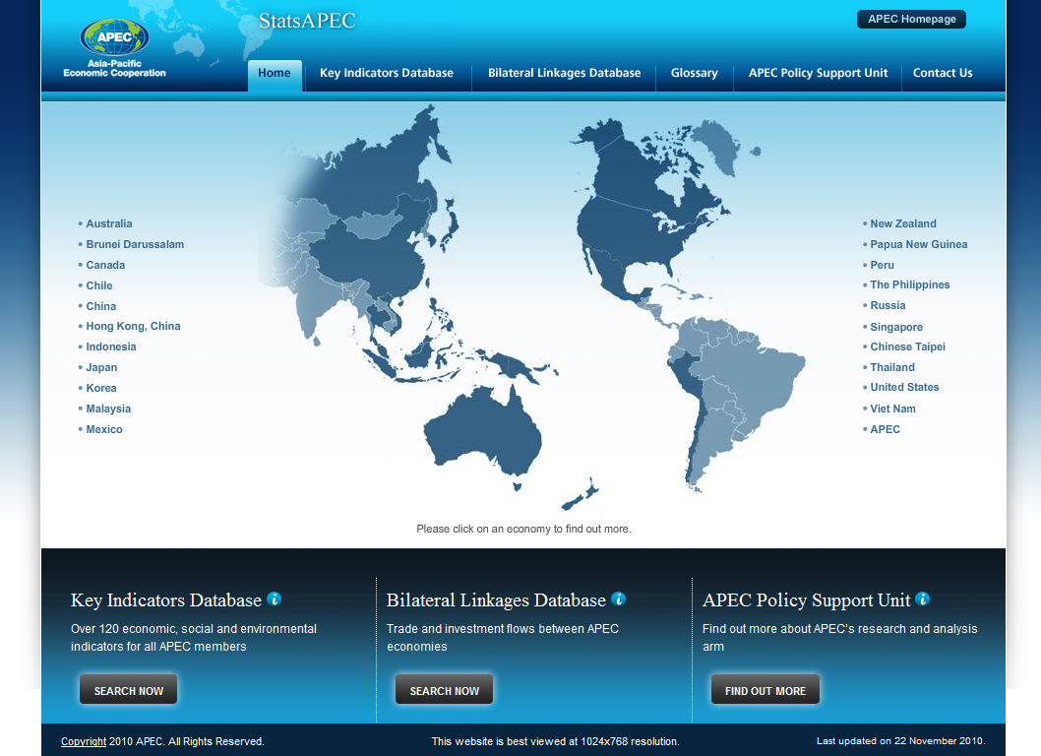

Slide 10
PSU work
PSU has completed 14 projects since the beginning of 2011.
Key projects:
TFAP II final assessment reports
Policy paper on TPP
Interim assessment of APEC’s Ease of Doing Business Initiative
Measurement framework for the IAP Peer Review Process and the Supply Chain Connectivity Initiative

Slide 11
Input Output Table – the Basics
Basic principle: inter-industry transactions
In general, IOT allows policy makers to:
conduct economic impact and national accounting studies;
conduct (regional) planning;
show linkages between sectors within the domestic economy;
analyze the interdependence of industries in an economy;
estimates the coefficients for multipliers, forward and backward linkages, and identify key or priority sectors.

Slide 12
Input Output Table –
Basic overview in APEC Economies
Economies | General information
Australia | •The Australian Bureau of Statistics compiles the I-O tables. •ABS has released 23 I-O tables. The latest was for 2007-08. •The I-O tables present information on 109 industry and product groups.
Brunei Darussalam | •The Department of Economic Planning and Development under Brunei’s Prime Minister’s Office is responsible for compiling the I-O tables. •Currently, BD only published one I-O tables 2005, 2005 is the benchmark year.
Canada | •Statistics Canada compiles the I-O tables for Canada. •I-O tables are published on an annual basis. Time series begin in 1961 for national I-O tables. The most recent release is I-O tables for 2008. •The I-O tables follow the North American Industry Classification System, 2002. (303 industries 727 commodities)
Chile | •Chile has two I-O tables one for 1986 and another for 1996. •The 1996 I-O table follows the regulations of the System of National Accounts 1993 (SNA 1993).

Slide 13
Input Output Table –
Basic overview in APEC Economies
Economies | General information
People's Republic of China | •National Bureau of Statistics compiles the I-O tables every 5 years, and every two and half year an annual table is compiled. Currently, I-O tables are available for the year of 1987, 1992, 1997 and 2002, while annual tables in year 1990, 1995, 2000 and 2005. •The classification of commodity sectors follows the Classification of National Industry, combined with needs of national accounts and macro-economy analysis. It’s a two-level system. The first level has 42 sectors, and the second level has 135 sectors.
Indonesia | • So far the I-O tables were available for the year 1975, 1980, 1985, 1990, 1995, 2000, 2005. The I-O tables are prepared every five years. Within I-O years, IO Updating Tables are compiled. The latest is the 2008 IO Updating table. • There are 175 industrial sectors included in the I-O table. Classification based on industry by industry classification refers to ISIC rev.3.1. The format of the I-O table follows the System of National Accounts (SNA) of the United Nations.
Japan | • Statistics Standards Bureau in Japan compiles the I-O tables; they have been compiled for every five years since 1955. • The Standard Industrial Classification for Japan (JSIC) is used in I-O compilation, with 190 sectors. The latest I-O table is for 2005.

Slide 14
Input Output Table –
Basic overview in APEC Economies
Economies | General information
Republic of Korea | • Bank of Korea compiles the I-O table for Korea since its first in 1960. Except 1963 and 1966, the rest I-O tables were compiled every five years. • The latest IOT is the 2005 I-O tables that were compiled with 403 basic sectors.
Malaysia | • The Department of Statistics compiles the I-O tables for Malaysia. • Six sets of Malaysia I-O tables were published so far, 1978, 1983, 1987, 1991, 2000 and 2005. The Malaysia I-O tables contains 12 sectors and 120 economic activities. • . The latest I-O tables (2005) use the concepts and definitions based on the System of National Accounts (SNA, 1993) and Handbook of I-O Table Compilation and Analysis (1999) published by United Nations.
Mexico | •Mexico has eight I-O tables, 1950, 1960, 1970, 1975, 1978, 1980, 1985 and 2003. The I-O table includes 20 sectors and 79 subsectors. •The 2003 I-O table follows the North American Industry Classification System 2002, as part of the NAFTA. The previous tables follow the regulations on the System of National Accounts 1993 (SNA 1993) made by UN. IMF, WB, OECD and EUROSTAT.

Slide 15
Input Output Table –
Basic overview in APEC Economies
Economies | General information
New Zealand | •Department of Statistics compiles the I-O tables. •NZ publishes the I-O tables approximately every 5 years. The new I-O table will come out in early 2012. •The 1996 I-O tables were at 62 industry level.
Peru | The Central Bank of Peru elaborated the first I-O table in 1950, which included 8 sectors; in 1959, they released annual tables for 1951-1957. The latest table is the one from 1994 issued by the National Institute of Statistics and Informatics, which was made with the technical support of the IMF. It is based on a classification of 287 goods and services categories, and 45 economic activities.
The Philippines | •National Statistical Coordination Board compiles the I-O tables. Philippines has nine I-O tables, starting from 1961. The first ones were prepared by the National Economic Council, and the Bureau of Census and Statistics; the 2000 I-O table is the latest. •The 2000 I-O covers the 240 by 240 industries and commodities; it follows 1993 SNA recommendations and 1994 Philippine Standard Industrial Classification (PSIC).

Slide 16
Input Output Table –
Basic overview in APEC Economies
Economies | General information
Russia | •The integration of the System of National Accounts into the Russian statistical practice begun in 1991. •Russian input-output tables for 1995 are the first basic tables, based on data of special single surveys of structure of outputs on production, and following SNA-93 principles. Based on 1995 I-O short input-output tables for 1995-2000 were designed.
Singapore | The Singapore Department of Statistics (DOS) compiles and publishes benchmark I-O tables once every five years. The fist I-O table was constructed in 1970. DOS had published eight sets of I-O tables for reference years 1973, 1978, 1983, 1988, 1990, 1995, 2000 and 2005. The IOT for 2005 was published in June 2010.
Chinese Taipei | National Statistics compiles the I-O tables. I-O tables were compiled for the year of 1981, 1984, 1986, 1989, 1991, 1994, 1996, 1999, 2001, 2004, 2006. Annual I-O tables are compiled for every year. I-O tables are revised every 1-3 years for consistency with the Standard Industrial Classification System, Industry, Commerce and Service Census or Production and Cost Survey. In 2006, there were 166 major sectors.

Slide 17
Input Output Table –
Basic overview in APEC Economies
Economies | General information
Thailand | •The Office of the National Economic and Social Development Board is responsible of Thailand’s I-O tables. •Thailand produces I-O tables every five years. The latest is 2005.
The United States | •The Industry Economic Accounts of the Bureau of Economic Analysis is in charge of the I-O tables. Tables are prepared for years ending in 2 and 7, which are based on detailed data from the quinquennial economic censuses. •The latest table is the one from 2002, and it includes 428 commodities to 426 industries and 13 categories.
Viet Nam | General Statistics Office of Viet Nam compiles the I-O tables. Currently available are I-O tables were of the year 1989, 1996 and 2000. There are 16 sectors in I-O tables of Viet Nam. The I-O table 2007 includes 138 commodities. The classification was based on UN System of National Accounts. The latest version of I-O tables were of the year 2007. Annual I-O updating had been undertaken.

Slide 18
Input Output Table -
International or Regional efforts
OECD input-output table:
break down inter-industrial transaction flows of goods and services into those that are domestically-produced and those that are imported, and into intermediate and capital goods;
harmonised for 40 countries (as of 2008).
The World Input-Output Database (WIOD):
Harmonized Supply and Use (Make) tables and domestic IO tables
Import tables
Dataset of trade in goods and services
Satellite accounts (socioeconomic and environmental indicators)
Asian IO table:
To depict the industrial network over 10 Asian economies.
Described the input composition and output distribution of each domestic industry vis-à-vis home as well as foreign economies’ industries

Slide 19
Input Output Table – Extension of Applications
Growth and related matters:
identification of most important factors or components influencing growth
highlighting the key industries or sectors across the economy
Supply-chain studies: issues related with Global Value Chain => Value-Added (VA) approach in trade statistics (the iPhone case)
Environmental issues: impact in terms of energy intensity, water use, emissions and wastes.
Socioeconomic issues: educational intensity, capital stock (ICT and Non-ICT), Intangible capital, FDI, etc.
Better policy making: evidence-based policy making

Slide 20
IOT Compilation and Construction - Challenges
Key challenges:
Data complexity: requires many complementary data (trade statistics, SAM, environmental stats)
Data compatibility and Standards:
internal and external consistency => The construction of internally consistent, survey-based international IO tables is extremely expensive.
different data standards and classifications between economies
Adjustments: what sort of adjustments need to be made to harmonize different types of IOT?
Coverage: bilateral, multilateral => where to start? It seems that many APEC economies have not updated their IOT for a while.
Updating: technology changes, prices change, and demand changes, all affecting the coefficients in the IOT. The results will not be valid if the coefficients are “out of date”.

Slide 21
IOT – Quality Dimensions
The Quality Dimensions – IMF/Eurostat common quality terms
Dimension | Key question
Relevance | Are the data what the user expects?
Geographical comparability/Methodological Soundness | Are the data in all necessary respects comparable across countries?
Accuracy and reliability | Can the data be trusted?
Consistency/Coherence | Are the data coherent with other data?
Timeliness | Does the user get the data in time and according to pre-established release dates?
Accessibility | Is the data easily accessible and understandable?
Source: Thage 2005

Slide 22
Conclusion
IOT statistics and analysis is a useful tool for policy making, including to show the impact of certain APEC measures in Trade Facilitation.
Constructing an international IOT is a long process.
Learn from what others have done: OECD, IDB, EC.
Strong networking, commitment and participation is critical.
Clear and realistic milestones and time frame to measure progress.
At early stages: be simple and practical yet maintain reasonable quality.

Slide 23
THANK YOU

