Slide 1
The Role of Brazilian Regions in the Global Value Chain Erik Dietzenbacher Joaquim Guilhoto Denise Imori

Slide 8
WIOD WORLD INPUT-OUTPUT DATABASE: Construction and Applications May 2009 – April 2012

Slide 9
Contents of the WIOD Database (at www.wiod.org)

Slide 10
List of Countries

Slide 24
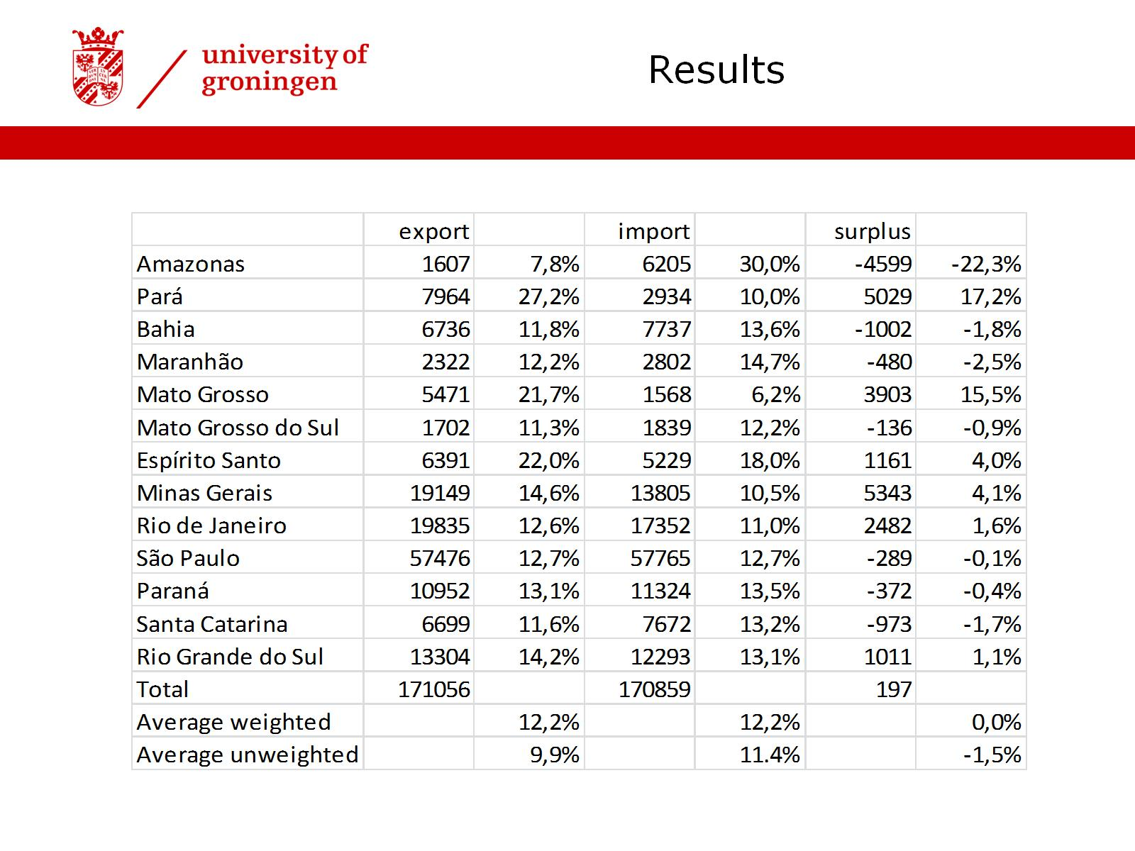

Slide 25
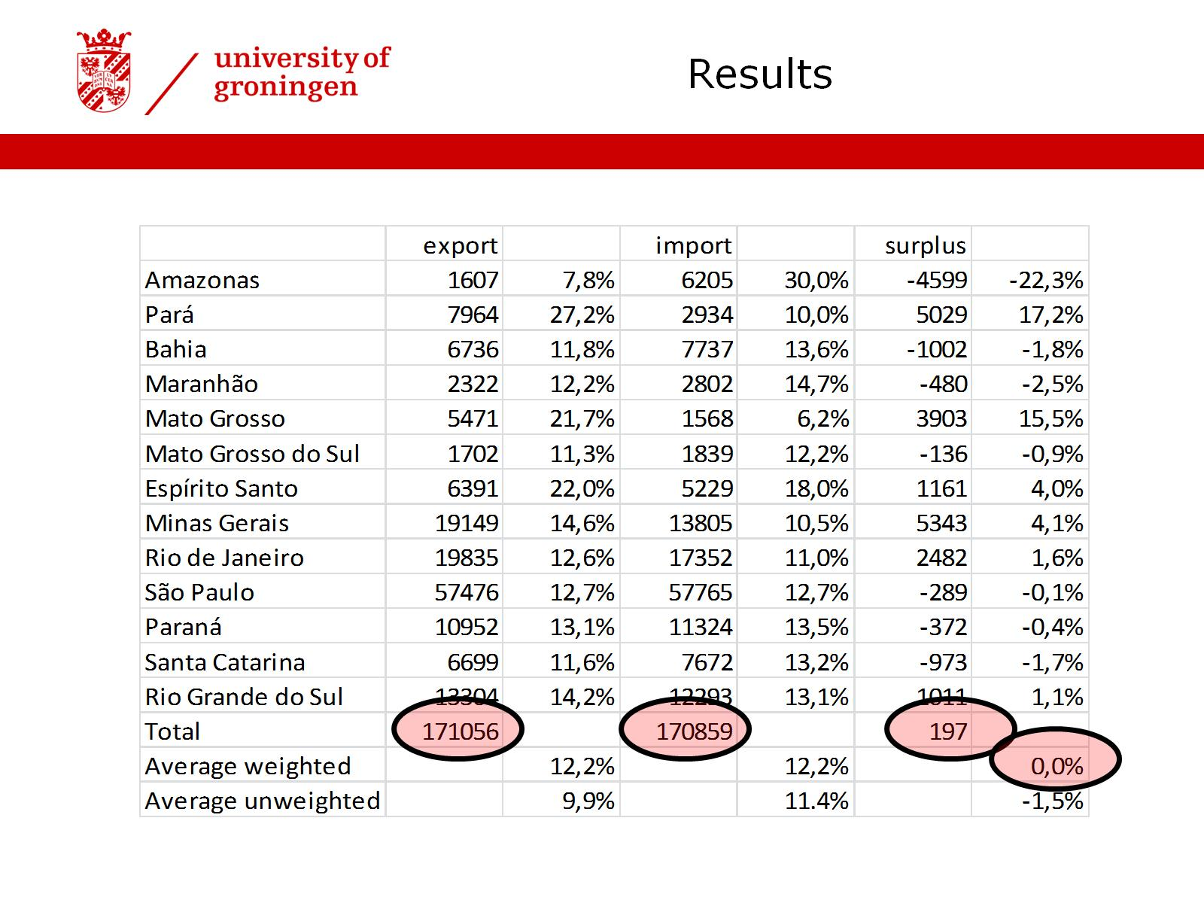

Slide 27
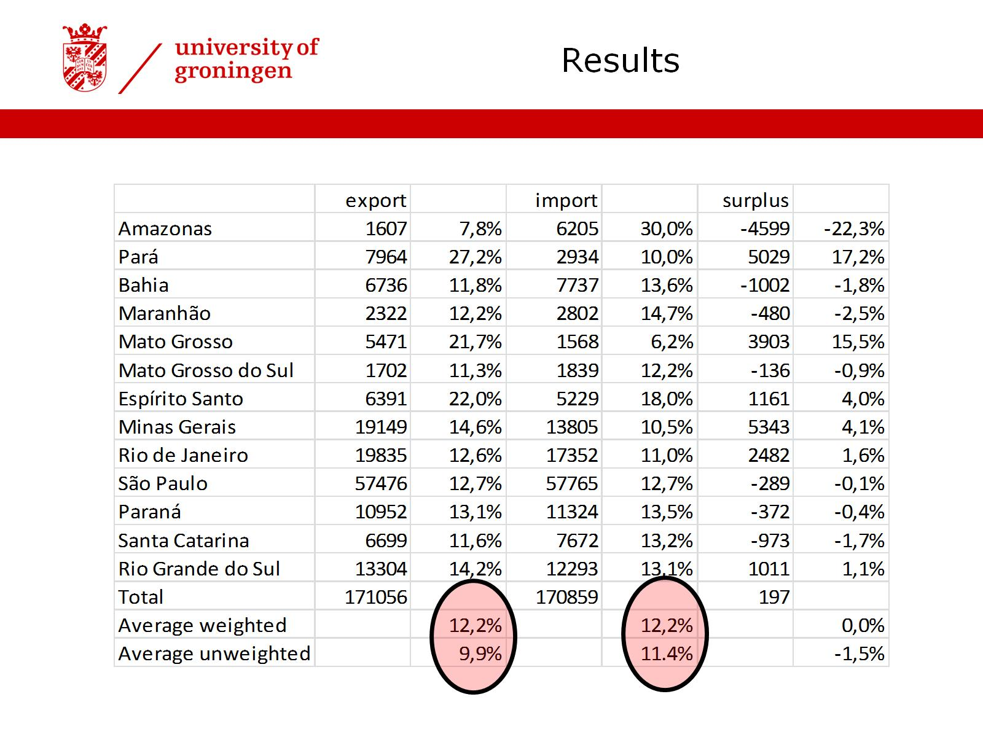

Slide 29
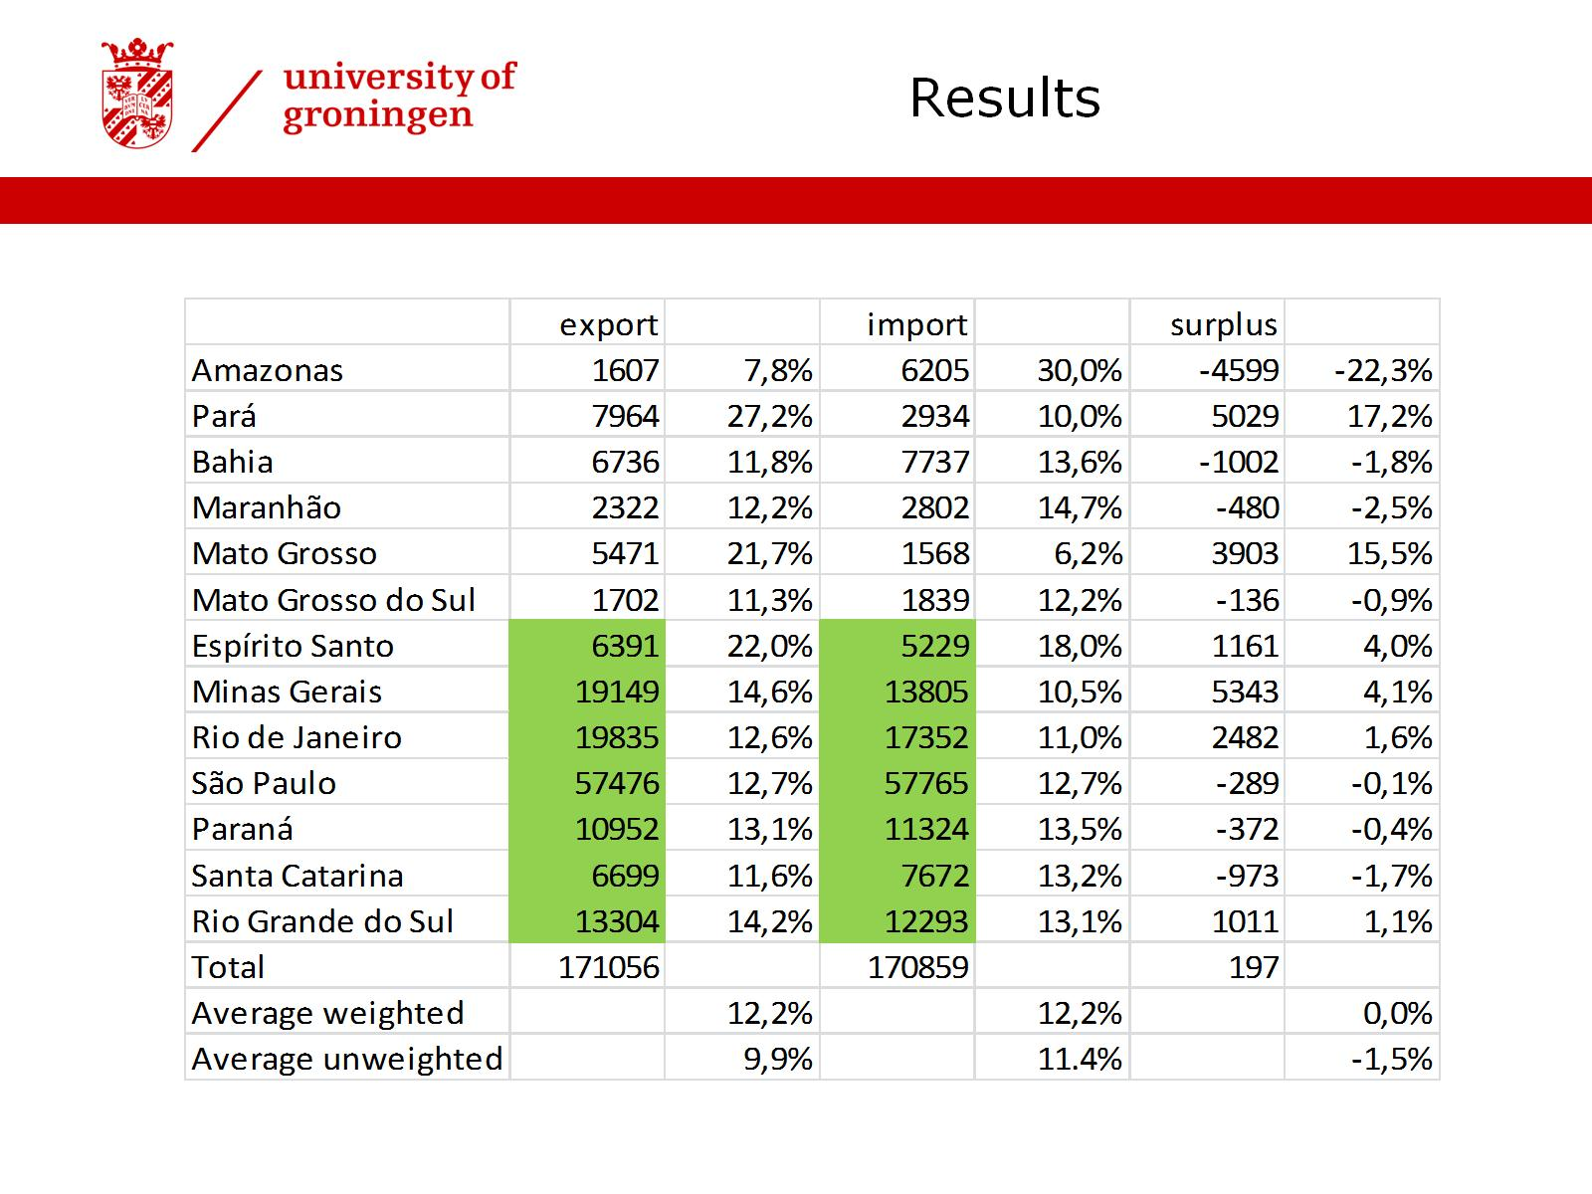

Slide 31
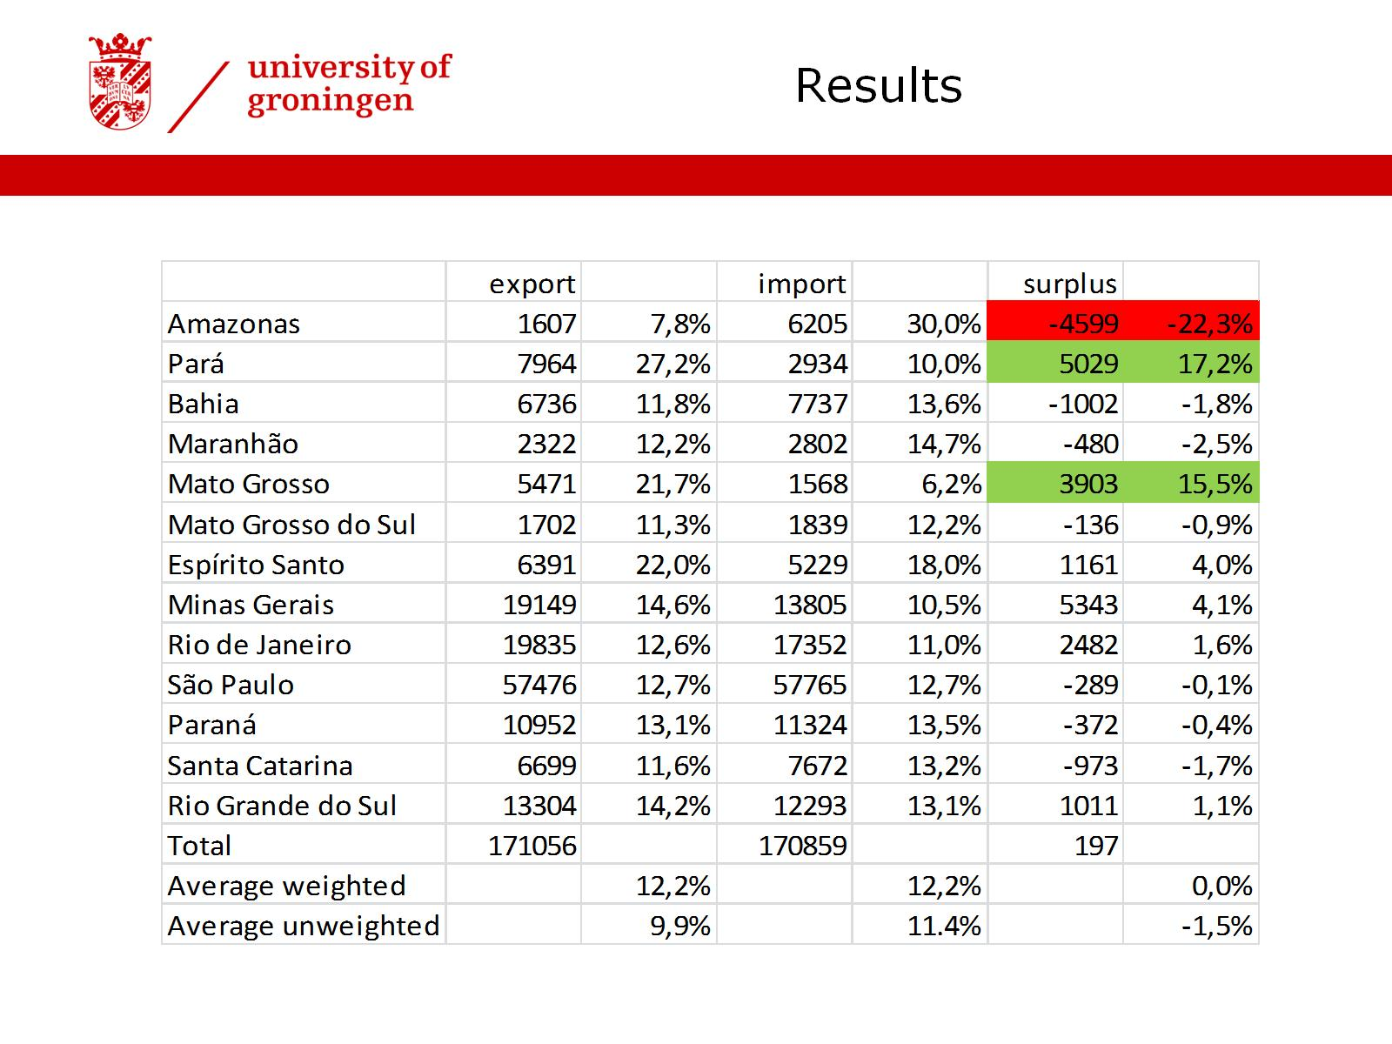

Slide 40
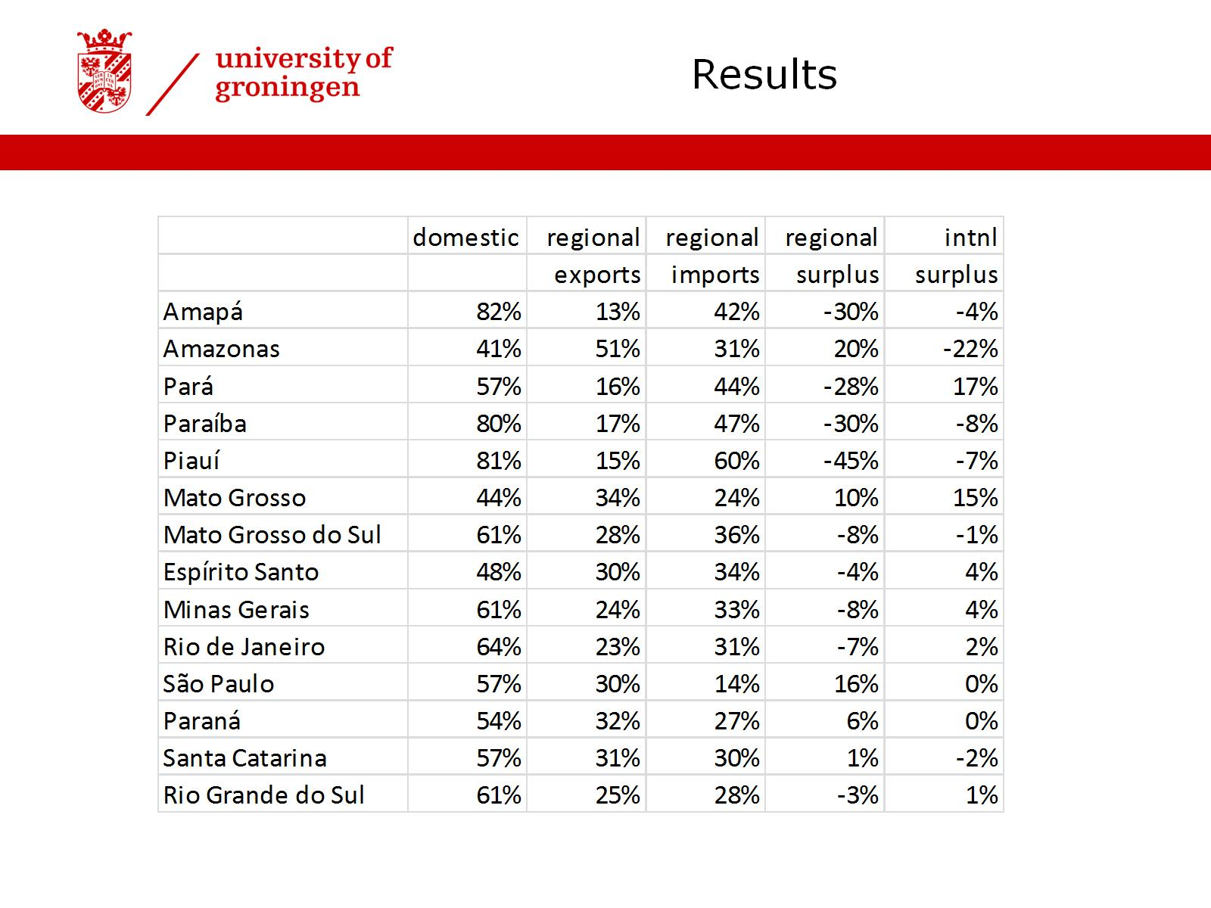

Slide 41
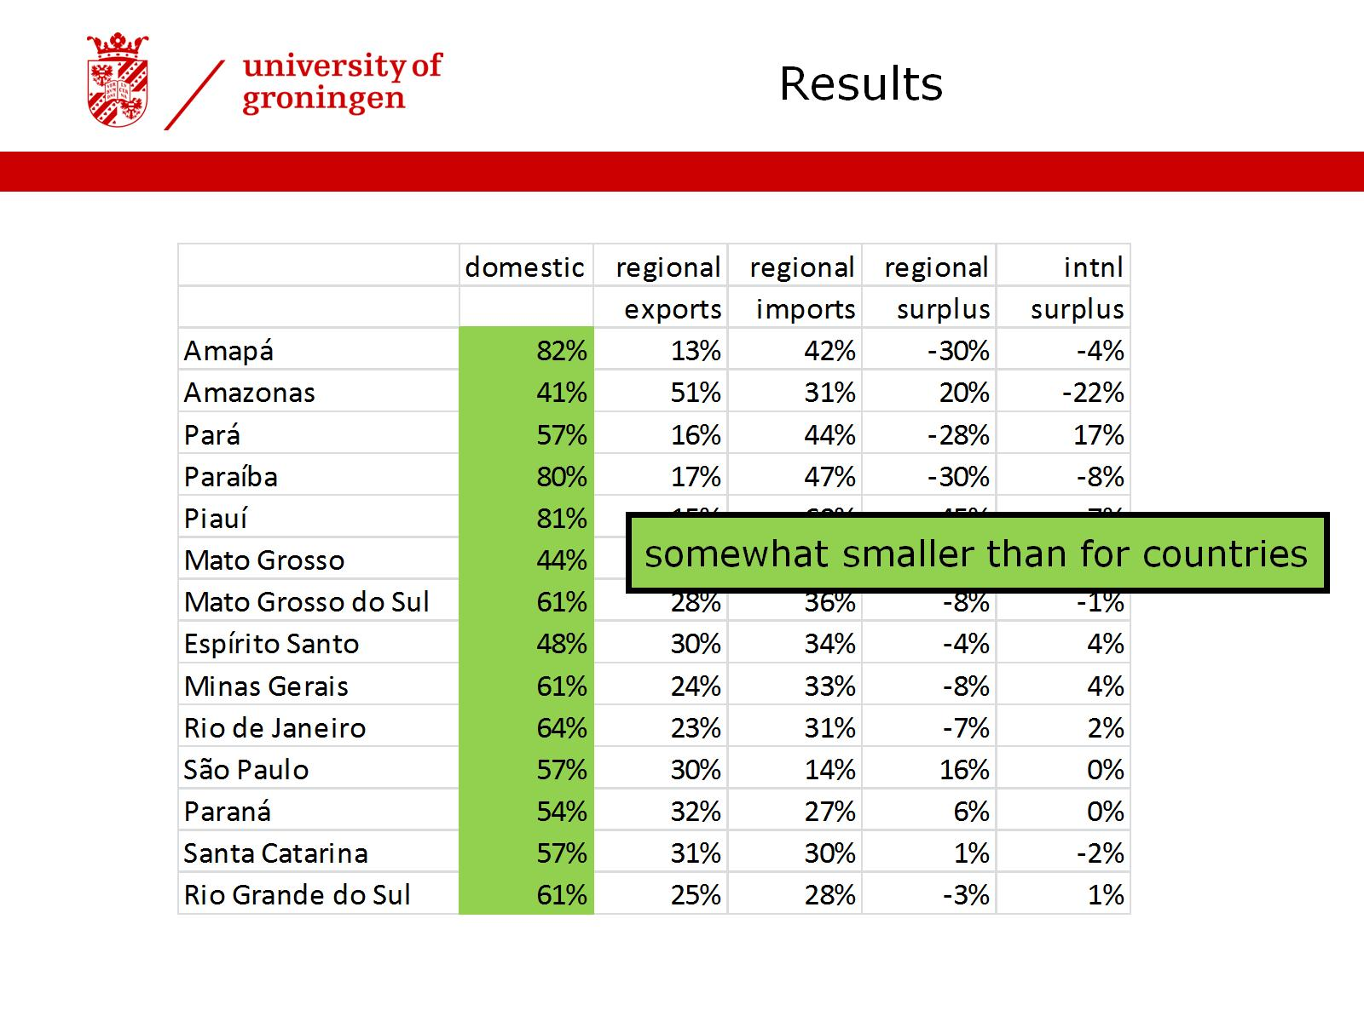

Slide 42
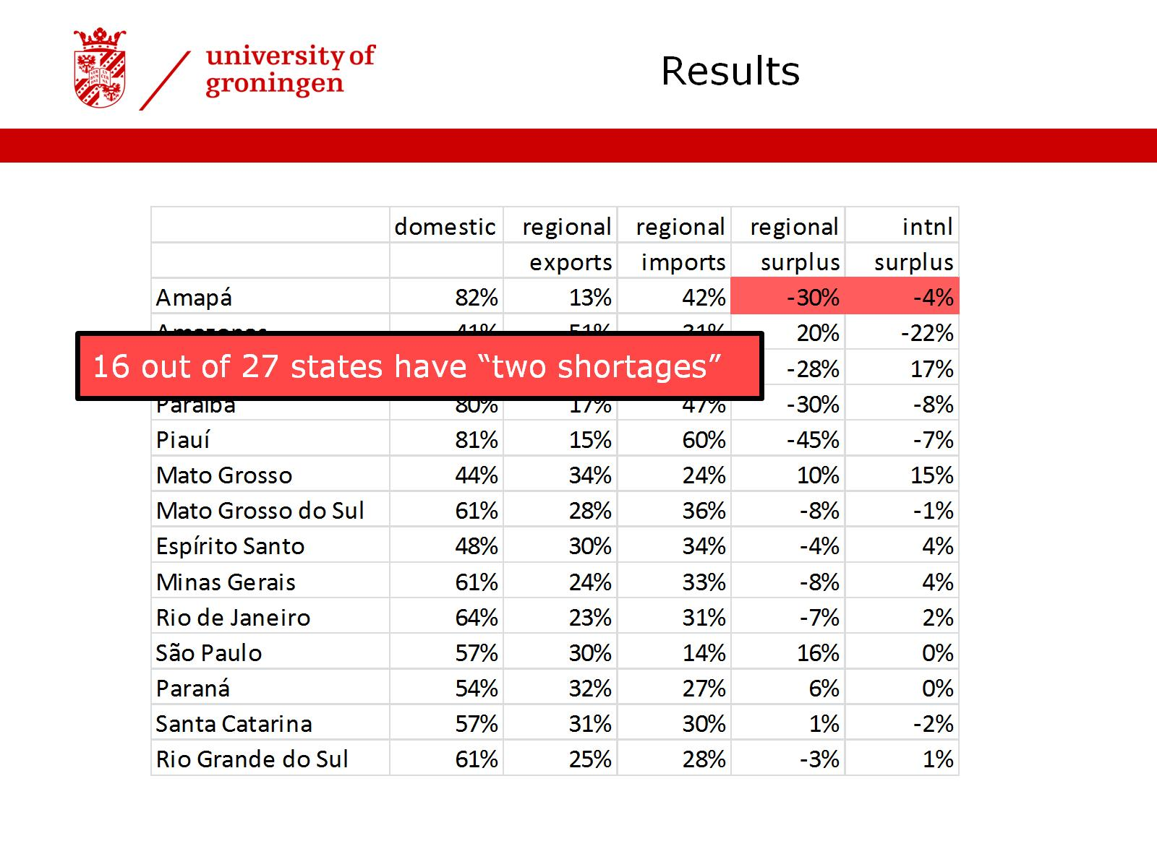

Slide 45
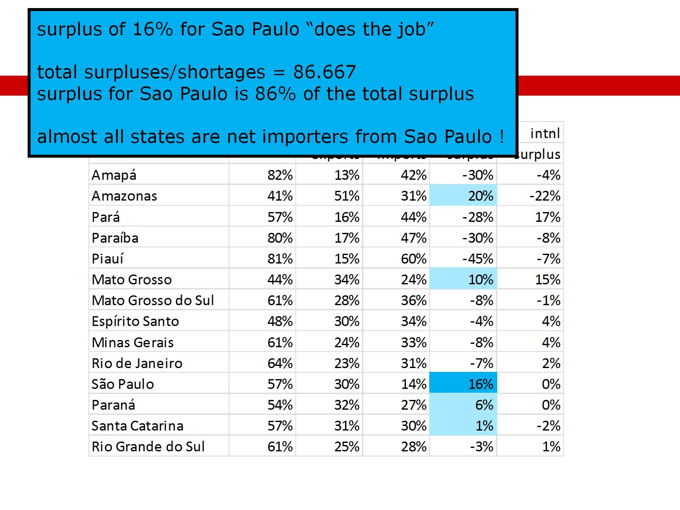

Slide 48
Thank you for your attention

