Slide 1

History of the national accounts mongolia

Slide 2
HISTORICAL BACKGROUND of national accounts of mongolia
The implementation of the System of National accounts in Mongolia and the development of related indicator systems can be considered in 5 stages. It includes:
    Before 1970
    1971- 1990
    1991- 2000
    2001-2009
    Since 2010

Slide 3
HISTORICAL BACKGROUND of national accounts of mongolia
I. Before 1970
According to Resolution No. 422 of 1960 issued by the Council of Ministers of the Republic of Mongolia, the National Statistical Office was assigned the critical mission of starting and optimizing macro-level statistical efforts. Within this work:
Balance of Monetary Income and Expenditure of the Population (1960-1964)
                Gross Social Product (Since 1965)
                Estimation of National Income (Since 1965)
                Estimation of the Balance of Labor Resources (Since 1965)
  Starting 1960, compiled “Balance of National Economy” (also known as “Material product system (MPS)”)
  In 1968, the main basis of the Material product system, the Input-Output table, was established for the first time for 1966 data.

Slide 4
HISTORICAL BACKGROUND of national accounts of mongolia
II. 1971-1990
The main economic indicators of the planned economy - Gross social product, National income and Material costs - were estimated in current and constant prices. During this period, used the 1968 and 1986 base prices.
Input output tables has been created in the following years:
1970 (32x32),
1975 (32x32),
1983 (85x85),
1987 (85x85)
In 1976, new methodologies were developed and introduced into balance sheet estimations. It includes:
Methodology of the Material product system;
Methodology for estimating gross and net product in provinces and cities;
Accordingly, methods were developed for estimating the balance of monetary income and expenditure of the population.

Slide 5
HISTORICAL BACKGROUND of national accounts of mongolia
III. 1991-2000
In the 1990s, the transition to market economy led to changes in macroeconomic statistics. This is the introduction of the “System of National Accounts”, which is applied in market economy countries.
This period is divided into 2 stages:
      Preparatory period for the introduction of System of National Accounts (1990-1995)
      Implementation period of the SNA (after 1996)

Slide 6
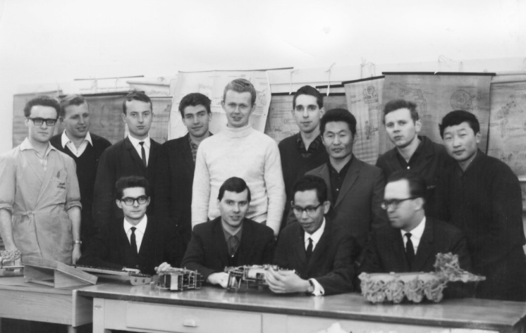
HISTORICAL BACKGROUND of national accounts of mongolia
Preparatory Period for the Introduction of the SNA:
    According to Resolution No. 71 of 1991 of the Government of Mongolia, a decision was made to prepare for the transfer to the System of National accounts.
    The Law "On Statistics" was approved for the first time in 1994.
      The first estimation of Gross domestic and National product was made in 1989,
      Between 1990 and 1995, GDP was estimated by the production approach, and the dynamics of national income of previous years were revised and transferred to the GDP estimation.
      Since 1993, experimental estimates GDP by expenditure approach.
      1989-1995 - move from MPS to SNA, revision of the GDP covering the period 1980 to 1994

Slide 7
HISTORICAL BACKGROUND of national accounts of mongolia
The period of implementation of the SNA
In 1996, the "Methodology for estimation of national and Gross domestic product at current and constant prices" was approved.
In 1995-1997, GDP was estimated by industry.
In 2000, Gross Regional Domestic Product was estimated.

Slide 8
HISTORICAL BACKGROUND of national accounts of mongolia
IV. 2001-2009
System of National Accounts implementation period with the improvements in principles:
In 1999-2005, based on international methods and standards, more than 10 methodologies and industry categories were developed and implemented.
Current accounts have been established in 5 sectors of the economy.
In 2003, the Foreign Economic Sector Account was established.
2002, 2007 – compiled IOT for 2000, and SUT, IOT for 2005
2008 – Quarterly GDP by production approach at 2005 constant prices

Slide 9
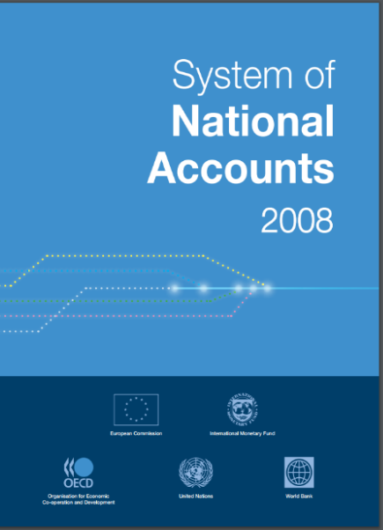
HISTORICAL BACKGROUND of national accounts of mongolia
Since 2010
  2010-2011 Benchmarked and rebased of National accounts based on SUT (2005) for period from 1990 to 2009, Updated of classification: ISIC 3.1 to ISIC4, for GDP (P) Re-estimated FISIM and allocation to users
  2012-2013 Estimation of annual GDP by expenditure approach at constant prices, Compilation SUT and IOT for 2010.
  In 2012-2013 preparations were made to move to the "SNA-2008" recommendations, and 4 methodologies and 3 classifications reflecting the changes in the recommendations were approved.
  Since 2013, it has been disseminated, estimated quarterly GDP by expenditure approaches.
  2019 – Base year change to 2015
  2021 – Compiled Social account matrix

Slide 10
Compliance with international guidelines
Methodologies are adopted and applied:
The methodology for estimation of GDP and GNI”, 2017 (compliance with SNA 2008);
“The methodology for estimation of quarterly GDP”, 2013 (IMF “Quarterly National Accounts Manual”);
“The methodology for compilation of goods and services accounts”; 2009
“The methodology for compilation of sequence of accounts” 2013, (current and capital accounts);
“The methodology for compilation of financial accounts, the other changes in assets accounts and the balance sheet” 2013.
“The manual for compilation of SUT and IOT”, 2013 (Eurostat Manual of Supply, Use and Input-Output Tables);
“The methodology for estimating productivities”. 2017
“The methodology for Social accounting matrix” 2021

Slide 11
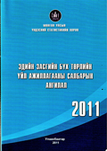
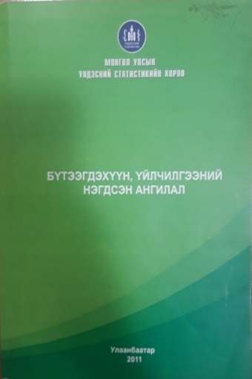
Compliance with international guidelines
Classifications are adopted and applied:
“Classification of all economic activities, rev.4” (UN ISIC rev4);
“Central product classification” (UN Central Product Classification Version 2.0);
“Classification of economic sector” (UN SNA 2008);
“Classifications of the functions, revenue and expenditure of the Government” (UN Classifications of the Functions of Governments)
“Classifications of goods and services of individual consumption by purpose” (UN Classifications of Individual Consumption by Purpose);
Classification of the purposes of non-governmental organizations”, 2011 (UN Classification of the Purposes of Non-Profit Institutions Serving Households);
“Harmonized commodity description and coding system”, 1998 (WCO Harmonized Commodity Description and Coding Systems);
“Classification of financial and non-financial assets”, 2013 (SNA 2008);

Slide 12



Thank you
WWW.NSO.MN | WWW.1212.MN

